Slide 1
Greatness in the Kingdom
Kingdom Character
(Matt 5:1-12)
Kingdom
Calling
(Matt 5:13-16)
Kingdom Conduct
(Matt 5:17-7:27)

Slide 2
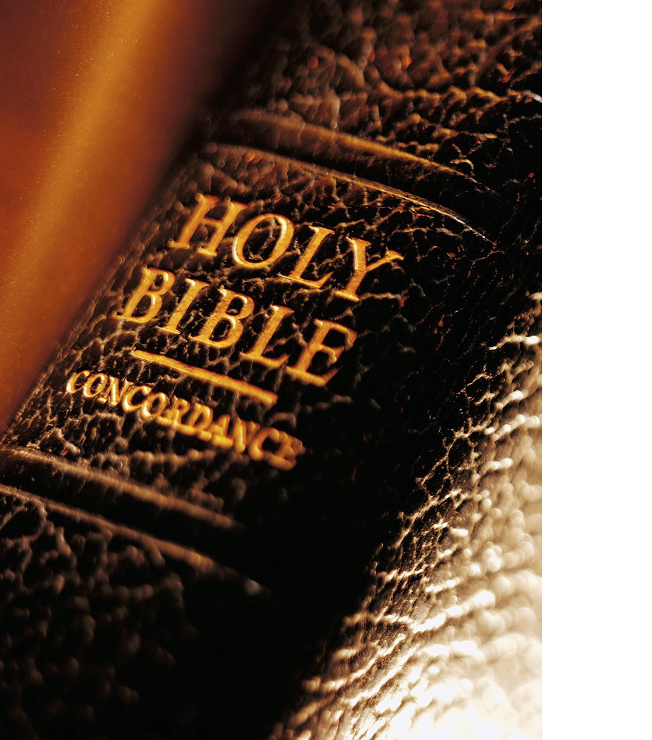
Matthew 6:1-4 (NLT)
¹ “Watch out! Don’t do your good deeds publicly, to be admired by others, for you will lose the reward from your Father in heaven. ² When you give to someone in need, don’t do as the hypocrites do—blowing trumpets in the synagogues and streets to call attention to their acts of charity! I tell you the truth, they have received all the reward they will ever get.

Slide 3
Matthew 6:1-4 (NLT)
³ But when you give to someone in need, don’t let your left hand know what your right hand is doing. ⁴ Give your gifts in private, and your Father, who sees everything, will reward you.

Slide 4
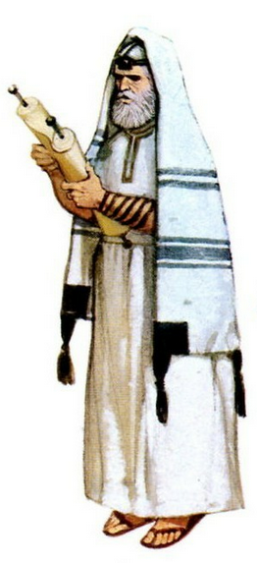
Greatness in the Kingdom
… must
surpass
that of the Scribes and Pharisees …
(Matthew 5:20)
… not as the hypocrites do ...
(Matthew 6:1-2)
Righteousness Warnings

Slide 5
Greatness in the Kingdom
In the same way, let your light shine before others, so that they
may see your
good works
(Matt 5:16)
Beware of practicing your righteousness before other people in order to be
seen by them
(Matt 6:1)
Righteousness Warnings

Slide 6
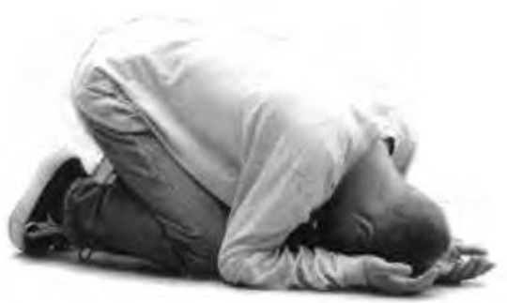
Greatness in the Kingdom
Whose?
the Father’s?
the world’s?
Righteousness Warnings

Slide 7
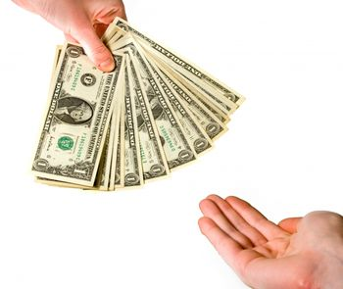
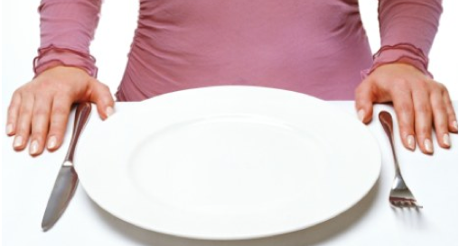
Greatness in the Kingdom
… this has implications for how we …
… give …
(Matt. 6:2-4)
… pray …
(Matt. 6:5-15)
… fast …
(Matt. 6:16-18)
Righteousness Warnings

Slide 8
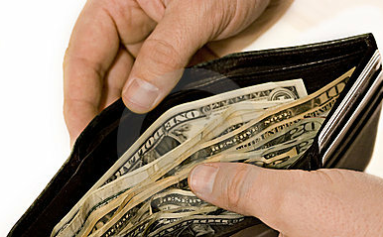
Greatness in the Kingdom
When you give …
(Matt 6.2)

Slide 9
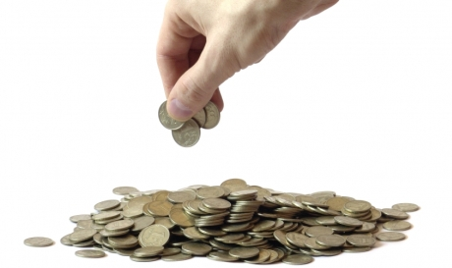
Greatness in the Kingdom
Rich
Large amount
“… they gave a tiny part of their surplus …” (Mark 12:44)
Poor Widow
2 Small Coins
“… gave everything she had to live on ...” (Mark 12:44)
When you give … give sacrificially!
(Mark 12.41-44)

Slide 10
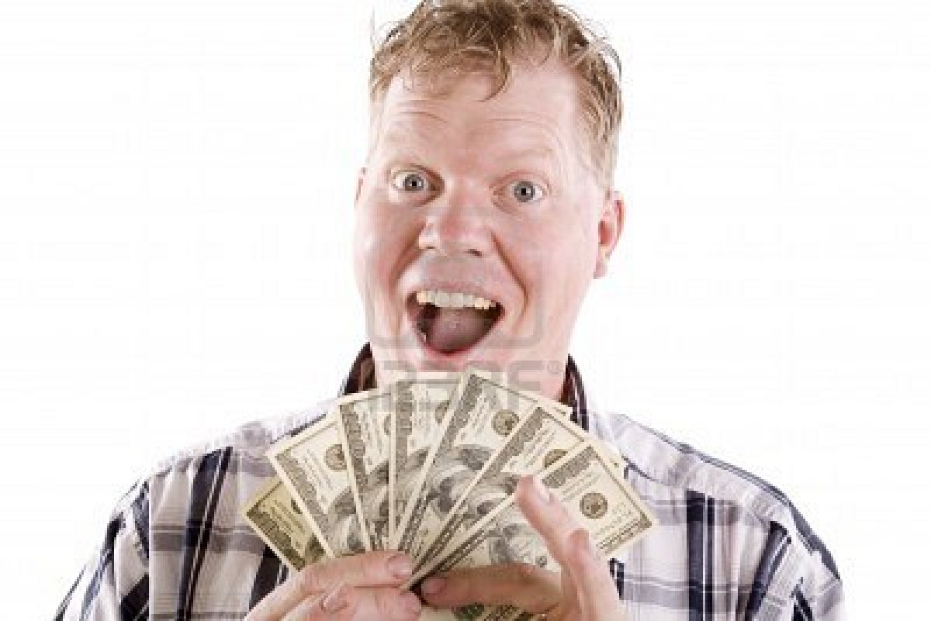
Greatness in the Kingdom
Whatever you give is acceptable if you give it eagerly.
(2 Corinthians 8:12)
When you give … give eagerly!
(2 Corinthians 8:12)

Slide 11
Greatness in the Kingdom
You must each decide in your heart how much to give.
(2 Corinthians 9:7)
When you give … give thoughtfully!
(2 Corinthians 9:7)

Slide 12
Greatness in the Kingdom
… not grudgingly ... and not in response to pressure
(2 Corinthians 9:5,7)
When you give … give willingly!
(2 Corinthians 9:5-7)

Slide 13
Greatness in the Kingdom
God loves it when the giver delights in the giving. (2 Corinthians 9:7)
When you give …
give cheerfully!
(2 Corinthians 9:7)

Slide 14
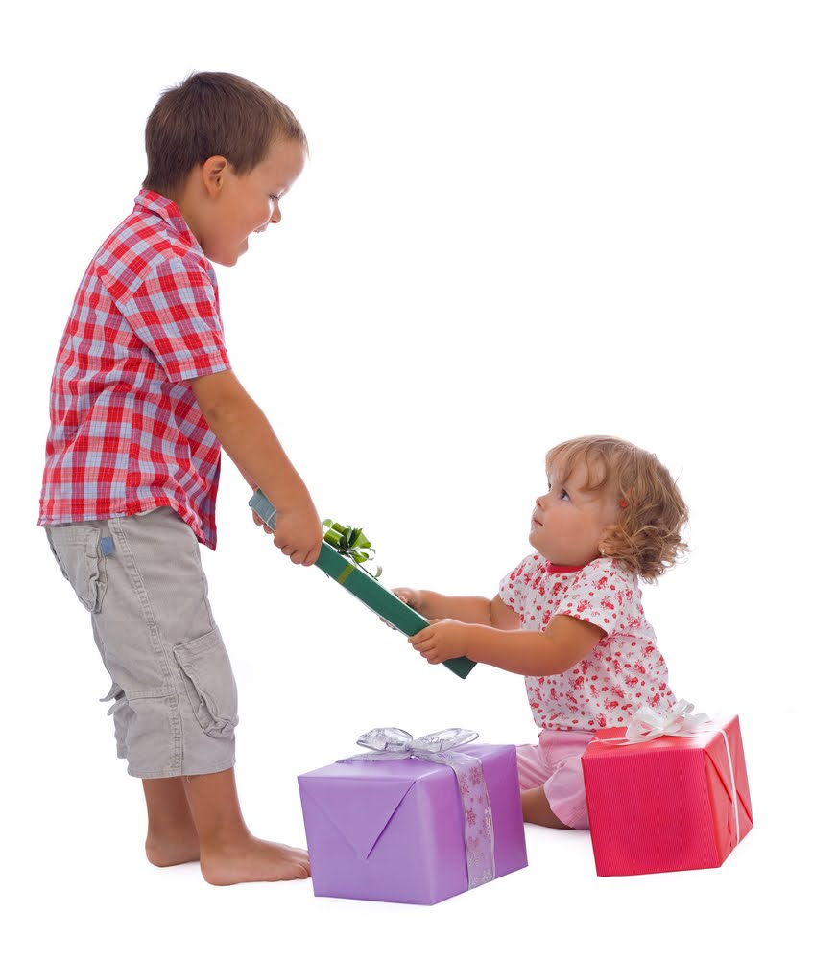
Greatness in the Kingdom
Remember this: whoever sows sparingly will also reap sparingly, and whoever sows generously will also reap generously.
(2 Corinthians 9:6)
When you give …
give generously!
(2 Corinthians 9:11)

Slide 15
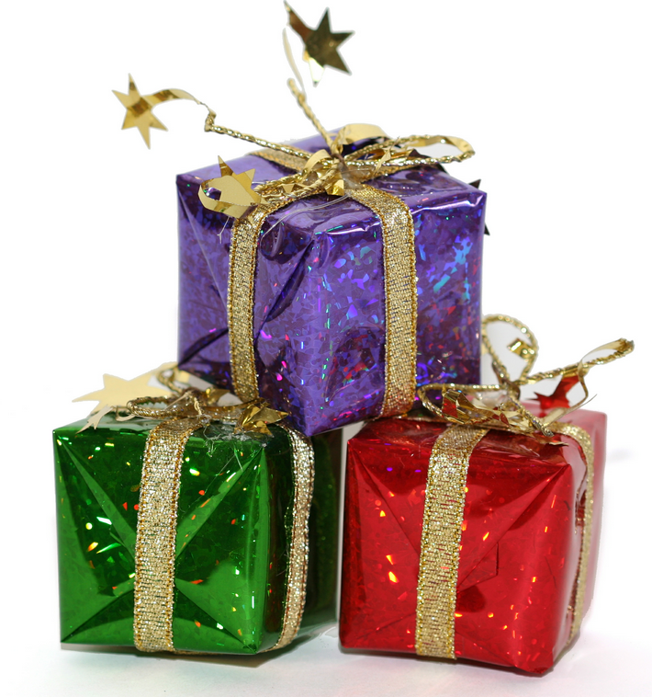
Greatness in the Kingdom
If your gift is to encourage others, be encouraging. If it is giving, give generously.
(Romans 12:8)
When you give …
give generously!
(2 Corinthians 9:11)

Slide 16
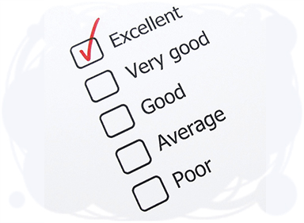
Greatness in the Kingdom
Since you excel in so many ways …. I want you to excel also in this gracious act of giving. (2 Corinthians 8:7)
When you give … give excellently!
(2 Corinthians 9:5-7)

Slide 17
Greatness in the Kingdom
L
R
When you give … give secretly!
(Matt 6.4)

Slide 18
Greatness in the Kingdom
'Well done, good and faithful servant! …. Come and share your master's happiness!' (Matthew 25:21)
The Father, who sees everything, will reward you.
(Matthew 6:4)

